Slide 1
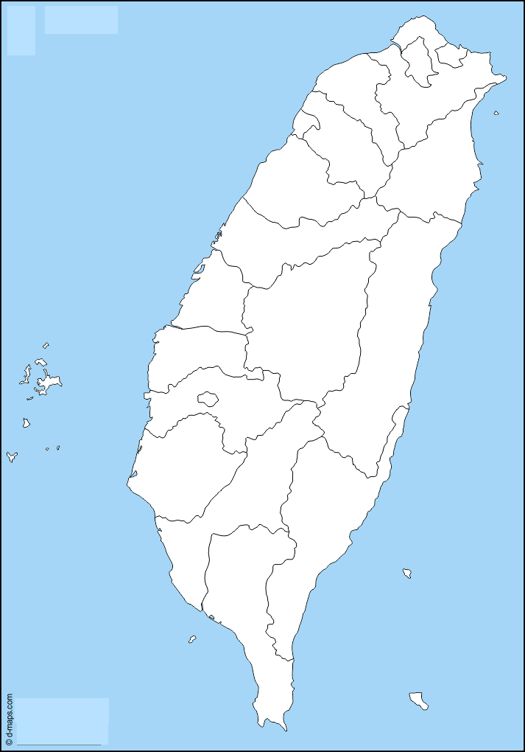





Taiwan Xiao-Chi
Differ between Northern and Southern Xiao-Chi
Northern Xiao-Chi
Southern Xiao-Chi
Shopping List
This website would introduce some common Taiwanese cuisine, including its history and making process.
Taiwanese cuisine, or its native nickname “Taiwan Xiao-Chi”, is considered as one of the special regional foods in Asia. Due to the colonization by both China and Japan, Taiwan Xiao-Chi have been deeply influenced by these two countries.
Taiwan Xiao-Chi
Northern Xiao-Chi
Southern Xiao-Chi
Differ Between northern and Southern Xiao-Chi
Shopping List

